Slide 1
Welcome
It’s All About Customer Experience
Danielle Walker
Director of Sales & Marketing
Ellis Partners in Management Solutions
dwalker@epmsonline.com
Cell phone: 847-707-2472
www.epmsonline.com
www.rentersvoice.com
Notes:
I want to introduce myself to you and tell you a little bit about my background. I started out in property management as a leasing consultant, back in 1997. My first experience was on a new development community in Springfield VA. I was hired at the very beginning of construction so we had no apartments to show, but we were pretty cutting edge because we had a computer animated video. It was a tour of the community, the model and the clubhouse. We leasing 100 apartments out of a mall kiosk for months before we had anything real to show That was an adventure. After a few months, I became a Leasing Manager, then a Marketing Manager with 20+ communities in my portfolio and eventually a Director of Education. I loved being creative, working with the teams to create training classes and marketing materials to set us apart from the competition. So all this to say, I’ve been in your shoes, I know how busy it gets with tours, follow up, paperwork, being there for your current residents. A big shout out to all of you for all you do everyday.

Slide 2
“Customer experience is the new competitive battlefield”
-Gartner
Notes:
Today, we are going to spend the next 25 minutes talking about CX. I’m going to give you 4 habits that will help create a great CX every time. Gartner, Inc. is an American research and advisor firm founded in 1979 in Stamford, CT. Gartner recently said “Customer experience is the new competitive battlefield”. What does “Customer Experience” mean? The CX is made up of all the interactions between us and our customers during their entire journey with us. In Last year, just in Dallas, Texas, 55k new apartments were built, I guess there’s some competition out there.

Slide 3
CUSTOMER EXPERIENCE SEPARATES YOU FROM THE COMPETITION
11
10
13
8
12
9
7
2
1
6
5
3
4
13 apartments communities within 1 mile of one another
Notes:
This is a picture of Las Colinas area. In this 1 mile radius, there’s 13 apartment communities. Think about how many apartment communities are within a 3 mile radius of your community. You might all have beautiful landscaping, great amenities, spacious apartments, a fantastic location but the one thing that will set you apart, is the CX you help create for your prospects and residents. So let’s talk about some companies who understand the power of CX.

Slide 4
Notes:
The first one that comes to my mind, is Chick-fil-a. They are known for great food, awesome service, they try to memorize their customers names and what the order on a regular basis. They are trained to be a ray of sunshine in your day and they try to connect with customers and make your CX the best it can possibly be. Raise your hand if you’ve been to a Chick-fil-A? Raise your hand of you go once per week?

Slide 5
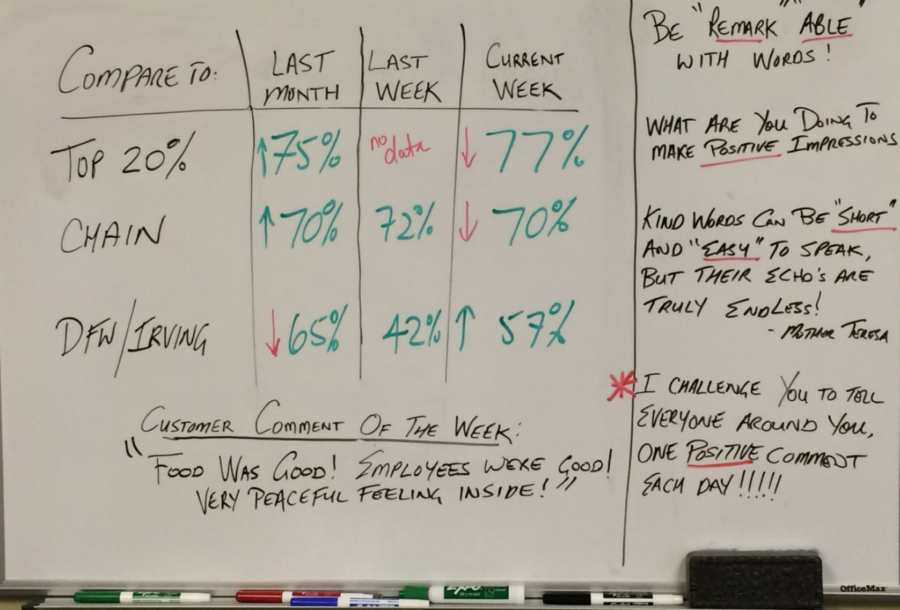
CREATING EMOTIONAL CONNECTIONS
Notes:
While driving through, I could see this “Whiteboard” through the window. So I snapped a picture of it, this is used to remind the Chick-fil-A team to use kind words, and make a positive impact on every single customer they touch! It says “Be Remarkable With Words”, Make a positive impact on someone, Chick-fil-A knows the value in connect with customers on an emotional level to create a great CX.

Slide 6
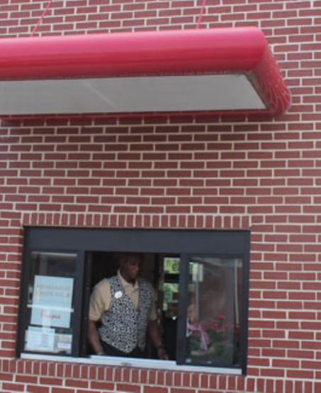
CREATING EMOTIONAL CONNECTIONS
Notes:
So this is my dog Mojo. SO Mojo loves to go for a ride in the car. So here’s Mojo, riding around in the front seat – so I pull into Chick-fil-a to pick up some food to take home for my kiddos and Mojo starts getting excited. His ears perk up, his tail is waggin’, I’m thinking why is he so excited about the drive thru. When we get to the window, he asks “would you like a treat for your dog?” I’m thinking “what? Wow, they give out doggie treats to every customer that comes through with a dog! As it turns out, my husband and my boys have been taking Mojo to Chick-Fil-A for quite some time, so what better way for Chick-fil-A to create a great Customer Experience and connect on an emotional level through your dog! And then the company starts getting free advertising from people who just love going to Chick-fil-A – Like this…….

Slide 7
Notes:
SO let’s talk about another company that understands the importance of CX. Krispy Kreme Donuts! How many of you have been to a Krispy Kreme? So you drive by KK and the first thing you notice, is the “hot donuts now”! So I’ll pull in the parking lot to sneak through the drive through a pick up some “hot donuts” but oh no, my kids are not going to allow that. They want to go in and see the KK donuts coming down the conveyer belt, piping hot!! And get their free donut! While you are watching the donuts come out, you can smell that delicious smell, it’s all about the CX.

Slide 8
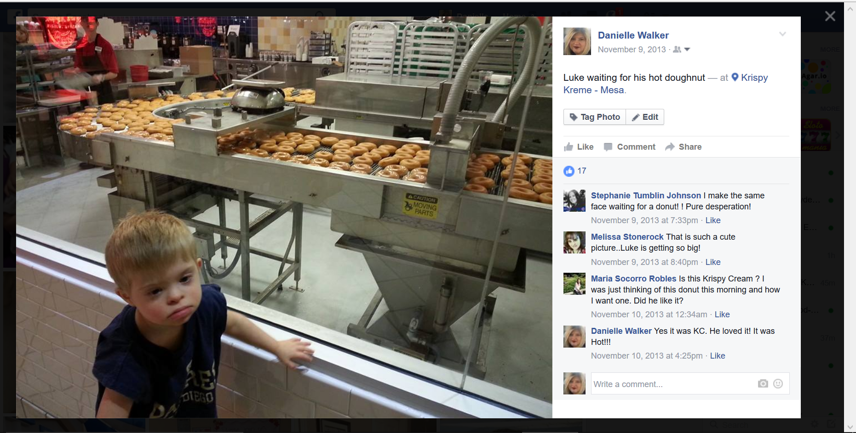
GENERATING POSITIVE WORDS / SOCIAL MEDIA
Notes:
And then you end up taking pictures of the donuts and your kiddos and all the sudden- your posting it Facebook, Twitter, Instagram – and now because KK is all about the CX, they are getting some great free marketing and advertising as your friends start liking your posts. SO they to connect with customers on an emotional level. What creates more emotion than my children, and my dog, right. These companies understand the importance of CX.

Slide 9
“People Don’t Buy For Logical Reasons, They Buy for Emotional Reasons”
- Zig Ziglar
Notes:
I think Zig Ziglar said it best, “People don’t buy for logical reasons, they buy for emotional reasons.” Do I spend $125 on my favorite jeans or shoes because it’s logical?? No, I do it because I love the way I look and feel in jeans, right? So you have find to connect with your customers on an emotion level and create that great customer experience..

Slide 10
Design is art constructed to meet objectives
Notes:
So let’s think about ways to design the CX. So how many of you remember those old Heinz ketchup bottles that we could never get the ketchup out, you turn it upside down, and pound on the bottom, trying to get that ketchup out, it still won’t come out, so finally you get desperate and get a butter knife to shove up inside the bottle to get he ketchup moving right? So the Heinz company heard that customers weren’t have a great experience so they started thinking outside the box, well, if we turn the bottle upside down, gravity will help us and if we make it plastic you can squeeze the ketchup out – and presto we have this new awesome design that we all know and love now right. It’s so easy to use, the experience is so much better. So it’s important that we think ahead, and think differently to design the CX.

Slide 11
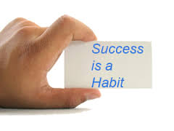
OWNING THE CUSTOMER EXPERIENCE
To Create An Experience,
Create Consistency,
To Create Consistency,
Create Habits
Notes:
SO today, we are going to talk about some basic habits, that will help you design a great CX every time for every customer. It’s important to create consistency, creating that consistency, will help you create good habits. Good Habits help you keep your residents happy. Remember that renting an apartment home is very personal, very emotional, in today’s market conditions, residents spend 35-40% of their income on their home. They expect us to deliver what we promise. So the first habit that will help us do just that …

Slide 12
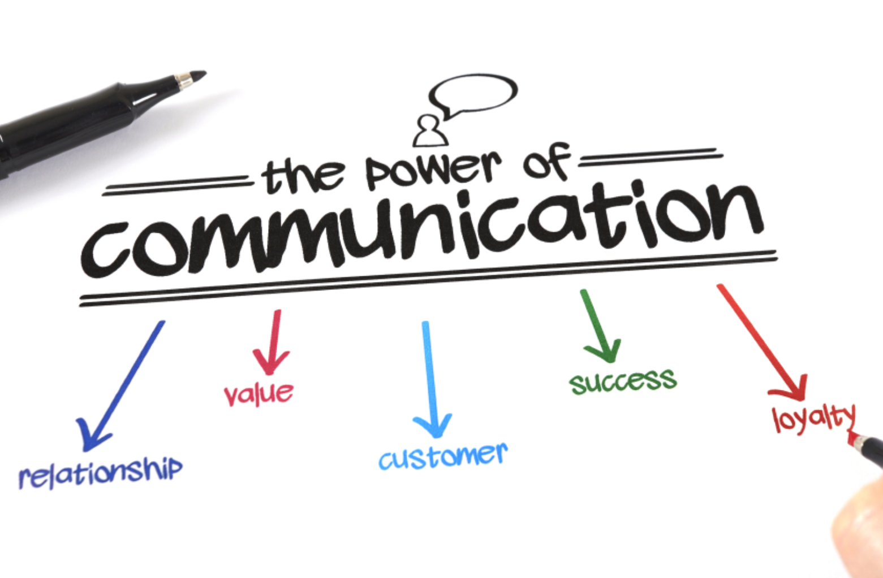
THE MOST ESSENTIAL HABIT…
1
Notes:
And the most essential habit, is communication. It is critically important to communicate clearly and often with your prospects and residents. Frequent communication helps build relationships and trust, it also adds value, it makes the customer feel important, creates loyalty and ultimately leads to success in achieving our goals. This is true in our personal lives too.

Slide 13
CONVERTING A LEAD TO PROSPECT
Notes:
So for us our leads, the journey begins with a telephone call, an internet lead, your website, reviewing ratings and reviews- then we begin creating that customer experience with every interaction the customer has with our brand, they see us as the brand. Keep in mind, they all count, they all play into this big picture that we call customer experience. we want to fully understand their needs and connect with them in a personal and emotional way.

Slide 14
TELEPHONE LEADS - FACTS
CREATING GOALS
TOP
AVERAGE
POOR
AVERAGE CALL TIME
7 MINUTES
35 SECONDS
5 MINUTES
45 SECONDS
3 MINUTES
48 SECONDS
Purpose of Call
Identify PROSPECT/Contact Info
Secure Appointment
Provide Directions
Determine PROSPECT Benefits
Describe Benefits Important to
PROSPECT
Provide Additional Awareness (i.e. website, neighborhood, etc.)
✓
✓
✓
✓
✓
✓
✓
✓
✓
✓
✓
✓
✓
✓
✓
✓
Source: Ellis Mystery Shopping Program
Notes:
Here’s what we know about telephone leads based on our Mystery Shopping Report data. A great telephone call with a lead can take almost 8 minutes. What we found is that collecting each piece of important information, like a name, phone number, an email address takes about 40 seconds. It also takes at least 40 seconds to determine their needs about the apartment home, then another 40 seconds to tell them about the apartment and describe the benefits and how this apartment will meet their needs. Keep this in mind when you are on the phone with a telephone lead, take your time to get all the information you need to discover they want and need, and then address those areas..

Slide 15
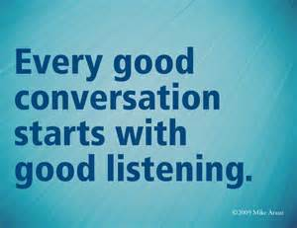
2
ACTIVE LISTENING
Notes:
So this brings us to our next important habit, Active Listening. Active listening is the key to communication, this is a habit you want to master. SO when I’m on the phone with my lead, and the service tech comes in my office to ask me a question about a move in for today, what do you I do? Do I try to multi-task and keep the call going while I answer the question? Or should I check my email while I’m listening to my lead tell about their needs, Or sometimes when the phone rings I am in the middle of finishing my market survey update, or looking to see which apartments are ready to show that day. Is that Active Listening? How can we practice active listen? Have a little pause sign that you hold up, when you are on the phone and some enters! Pretend that person on the phone, is the room with you, and make them the center of your attention. Remove distractions – and take notes on what the lead is telling you. If they are in the room with room with you, make eye contact. We also have to stop talking – this one is difficult for me ☺ Be patient.

Slide 16
FACTS ABOUT PROSPECTS
85% of prospects that visited a community are interested in renting.
48% of prospects are wanting to rent within the next 30 days.
Top reasons for moving are to due to location.
Source: Ellis Prospect Survey
Notes:
What we know based on the data we have from our prospect survey is that 85% of prospects that visit you, are really interested in renting from you. We also know that 48% of those prospects, want to rent an apartment within the next 30 days. The number 1 reason for moving is location. Number 2 and 3 are resident who leave because of a negative customer experience.

Slide 17
CONVERTING PROSPECT TO RESIDENT
Notes:
So when your prospects come to see the community and the apartment, know that 85% are very interested in renting! What can we do to create a great customer experience while on tour with a prospect. 1. Communicate – clearly and often , 2. use Active Listening skills – make eye contact, give them your full attention, listen carefully, takes notes about their needs, repeat it back to them to be sure you understand, explain the benefits of your community based on what they just told you. use picture words, (a queen size mattress would fit in this closet) and share a positive personal story. “I live here and I love being a resident here.”
Just for a moment, let’s pretend that you are moving in today to your community, so now you are the resident.

Slide 18
What Do We Expect on Move In Day….
A Clean Apartment (smelling nice and clean)
Clean “Working” Appliances
Plumbing “Working” (showers, toilets, sinks)
Keys – Apartment, Fitness Center, Laundry Area, etc.
Fresh Paint (no holes, etc.)
Clean Dry Carpet
No Bugs
Move In on “Move In” Day
Familiar Faces to Greet Us
Notes:
As a resident, let’s talk about what we expect in our new apartment. All of these factors play into a great customer experience.

Slide 19
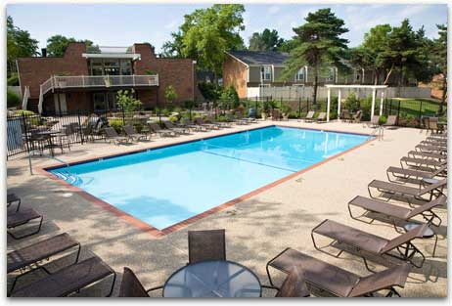
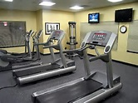
What Do We Expect from Our Community….

Slide 20
What Do We Expect…
Amenities accessible and in good condition
Fitness Equipment
Community Gates
Pools
Laundry Areas
Community Curb Appeal
Landscaping
Trash Removal
Outside Lights
Pet Areas Clean

Slide 21
First Impression / Move-in Day!
Notes:
It’s Move in Day for your residents. How do we create that great CX? Let’s talk about ways we can that we own the customer experience in advance, so let’s do some planning before move in day. What are some things we can do to prepare for our resident’s move in day?

Slide 22
How Do We Own the Move In Experience
Walk the apartment, with maintenance (if possible)
Inspect the apartment (open cabinets, etc.)
Allow time to fix issues noted (48 hours before)
Create a hand written “Welcome” note
Partner with a Pizza place to offer a free pizza on move in day
Provide Neighborhood Information
Do what you say you’re going to do
Follow Up – check in 24 hours after move in
Notes:
We can walk the apartment the day before- make sure it’s clean, it smells good, make sure everything is working and in good order, create a hand written note as a “welcome”, partner with Papa John’s or Pizza Hut to provide a free pizza on the day of move in, put a few bottle waters in the refrigerator,. On move in day…. How about walking the new resident to their apartment for the first time, make sure the keys work. There’s so many little things we can do, to make a huge impact on your resident having a great customer experience! It doesn’t have to cost anything, it’s the little things that really count. Be sure to keep your promises and follow up a day or two after move in with a quick phone call. Take ownership. This is my resident, I want them to have a great experience.

Slide 23
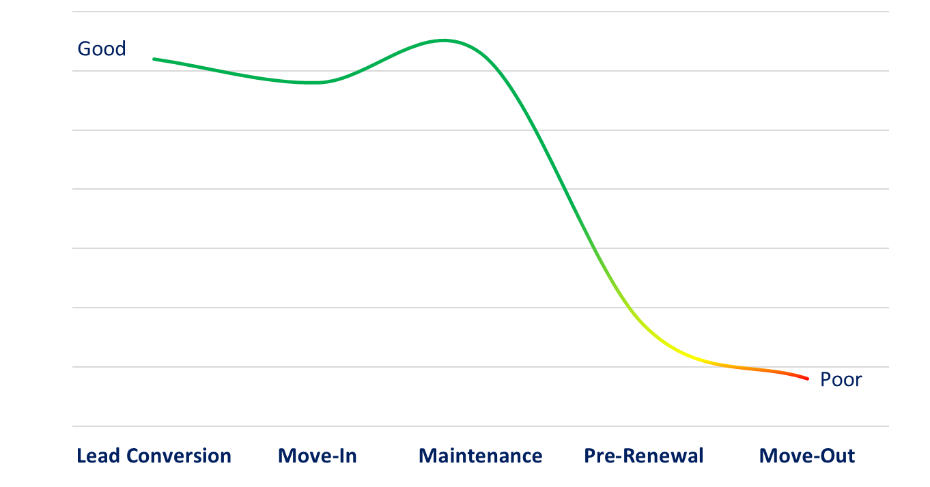
RESIDENT EXPERIENCE FACTS
# of Months when residents begin to characterize experience as negative
Good
1-3
Experience
Source: Ellis Resident Survey
Notes:
What we know from the data in our Ellis Surveys is that it only takes 1-3 months for a “good experience” to begin to fall short and be described as a negative experience. Does that surprise you? We have a tremendous amount of contact with our residents in the first few weeks, so as a prospect, during the tour, getting them signed up for an apartment, helping them with the keys on move in day and then…our then what happens? The contact with the resident drops off dramatically – so in a relatively short period of time, the resident begins to change from a positive experience to a negative one- but it doesn’t have to be that way.

Slide 24
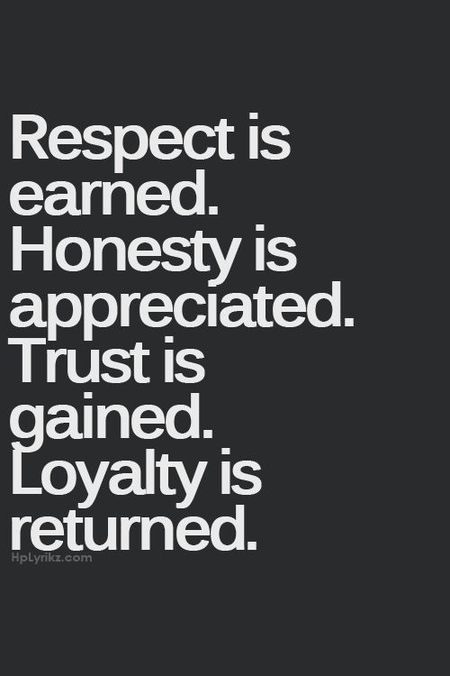
“CONNECT WITH RESIDENTS THROUGH FEEDBACK”
3
4
Notes:
That’s why our 3 habit is so important- It’s Connect, We have to find ways to connect with our residents and get their feedback.

Slide 25
OPPORTUNITIES TO CONNECT THROUGHOUT THE RESIDENT JOURNEY
Visits Community
Lead Conversion
Signs Lease
Moves In
Service
Work Orders
Move In
Moves Out
Renewal Discussions
Pre-Renewal
Move Out
Notes:
Connecting on a personal level is powerful. Our Ellis Survey program gives opportunities to connect all along their journey. After the tour, - we really want to know how was the first impression, did they feel comfortable, would they seriously consider calling this home and how soon are they looking to move. after Move In, we want to know if there is anything they need or any part of the move in process we need to improve upon, after a service request is completed, we need to know “were quick, were we efficient, did we clean up after ourselves, did we communicate about the service request and the work that has been completed? A few months before the lease expires, we want to know if their plan is to renew and if not why? All of this is very valuable feedback and will allow you to convert prospects faster and help you take action to improve the overall customer experience for your current and future residents. Then we are going to follow up even after they move out with a move out survey. This will allow you too see the entire CX from prospect to when they move out from us. All of our surveys are short, 10-12 questions and they are all ready for Smart devices, so they can take a survey on their smart phone, it’s that easy.

Slide 26
SENTIMENT / THE FIRST IMPRESSION
Source: Ellis Resident Survey
Notes:
Remember you only have 1 chance to make a great first impression – it is so critical important to the overall customer experience. Then you want to follow up with a great move in experience and take care of their maintenance needs. What are your residents saying about you? What do you want your residents to say about you? What words are they using to describe their experience? Think about it.

Slide 27
4
RESPONDING TO YOUR RESIDENTS
Notes:
The final habit, is responding to your residents, following up with and following through – do what you say you are going to do. Respond immediately, if you can respond immediately when you see a message pop up, Do it. Don’t let that opportunity pass you by. I make it a personal habit to respond immediately, as soon as I see a request. If you make it a habit, you will build more loyalty with residents and earn more valuable feedback.

Slide 28
BENEFITS OF CONNECTING AND RESPONDING
Communities that responded faster and answered the resident more achieved:
A Higher Loyalty Score,
A Higher Likelihood to Renew,
More Resident Surveys
Source: Ellis Resident Survey
Notes:
Here’s what we know from the data from our survey program, communities that respond faster and more often…..have more loyal resident who stay with them, refer more and give us more feedback.

Slide 29
OWNING THE RESIDENT EXPERIENCE
Communicate
Listen
Connect Through Feedback
Respond Quickly
1
2
3
4
Notes:
OK, to recap… our 4 habits that help you design a great customer experience – communicate
listen
connect
And respond

Slide 30
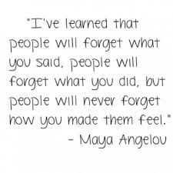
OWNING THE RESIDENT EXPERIENCE
Notes:
I want to leave you with this quote….. I’ve learned that people will forget what you said. People will forget what you did, but people will never forget how you made them feel.
It’s been a pleasure being here, Thanks for having me today-

Slide 31
Thank you! Want to learn more?
Call Danielle Walker @ 847-707-2472
Or email me
dwalker@epmsonline.com
www.epmsonline.com
www.rentersvoice.com

